Slide 1
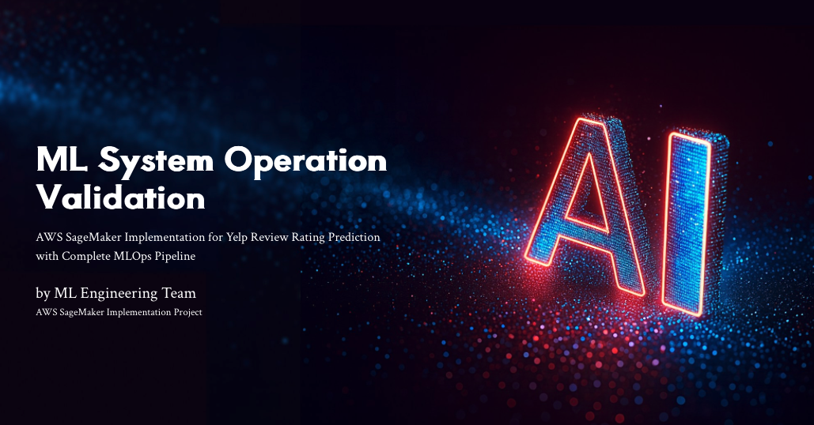
Notes:
Slide 1 – Title & Introduction (0:00 – 1:00)“Hello everyone, and welcome to our presentation on Machine Learning System Operation Validation using AWS SageMaker.This project demonstrates a full end-to-end ML pipeline that predicts Yelp review ratings directly from text.We’ll walk through the business use case, the AWS architecture, data preparation, feature engineering, model development, CI/CD automation, and system monitoring. By the end, you’ll see how an ML system can be validated not only by accuracy but also by reliability, scalability, and observability.”

Slide 2
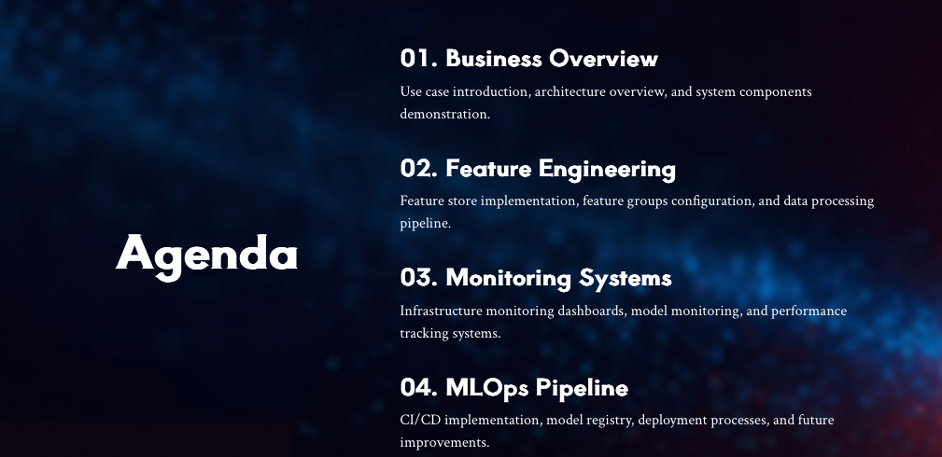
Notes:
Slide 2 – Business Use Case & Objectives (1:00 – 2:00)“Customer reviews on Yelp heavily influence restaurant traffic and reputation.Yet analyzing thousands of free-form text reviews manually is impossible.Our objective was to build a system that automatically predicts the 1-to-5-star rating from review text.The goals are to cut manual effort, deliver faster sentiment insights, and provide measurable KPIs like model accuracy and inference latency.In short, we automate subjective review scoring with explainable, repeatable machine learning.”

Slide 3
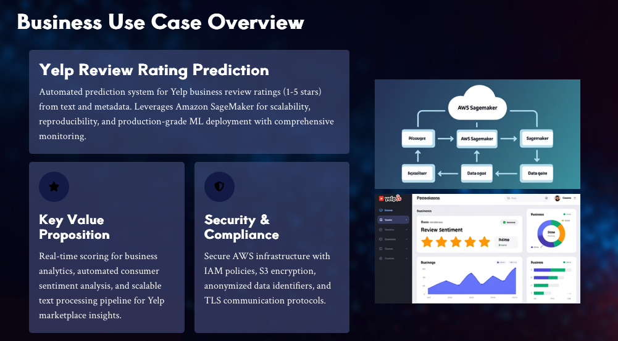
Notes:
Slide 3 – AWS Architecture Overview (2:00 – 3:00)“This diagram shows the full pipeline in AWS.Data is stored in Amazon S3, cleaned through SageMaker Processing Jobs, and transformed into reusable features in the Feature Store.The model trains inside SageMaker Training Jobs, registers in the Model Registry, and deploys to a managed Endpoint for real-time inference.CloudWatch monitors performance, while CodePipeline and CodeBuild automate retraining and redeployment.Every stage is connected horizontally for traceability from raw data to live predictions.”

Slide 4
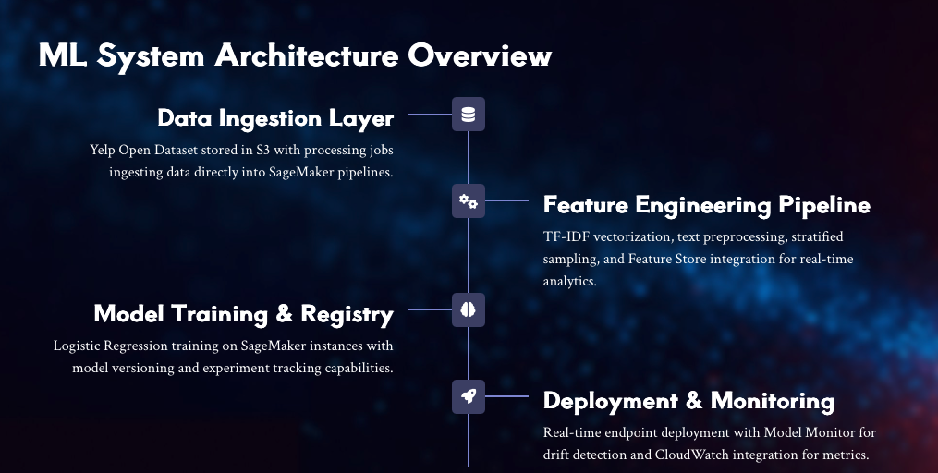
Notes:
Slide 4 – Data Engineering & Pre-processing (3:00 – 3:45)“We started with the Yelp Open Dataset.Text reviews pass through a cleaning pipeline—lower-casing, punctuation and stop-word removal, and tokenization.The cleaned data is split 80 percent train, 10 percent validation, 10 percent test.All of this runs inside a SageMaker Processing Job using the Scikit-learn container, giving us reproducible preprocessing independent of any local environment.”

Slide 5
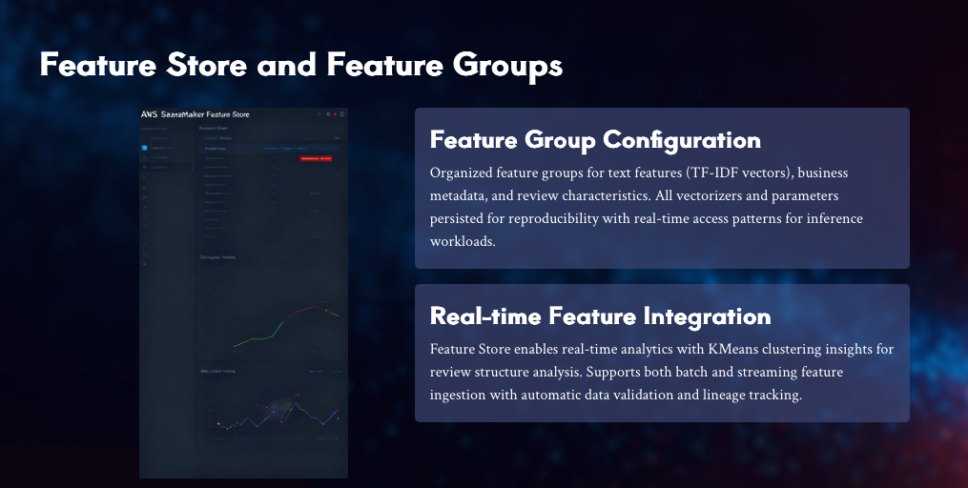
Notes:
Slide 5 – Feature Engineering & Feature Store Integration (3:45 – 4:30)“Each review’s text is vectorized using TF-IDF with up to 5 000 terms and bigrams.These numerical vectors are stored as feature groups in the SageMaker Feature Store, ensuring the exact same features are available to both training and inference.This consistency is key for operational validation—no feature drift between offline and online environments.The diagram here shows text flowing through TF-IDF into the Feature Store.”

Slide 6
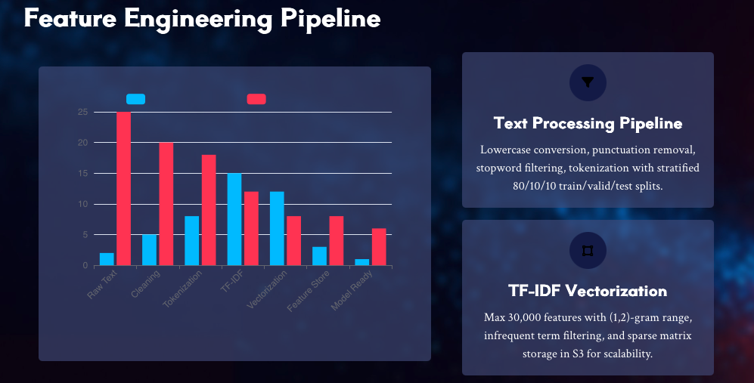
Notes:
Slide 6 – Model Training & Evaluation (4:30 – 5:15)“We chose a multiclass Logistic Regression model—simple, interpretable, and efficient.It runs inside a SageMaker Training Job, with hyper-parameters like C = 1 and max_iter = 1000.Evaluation metrics include Accuracy, Precision, Recall, and F1-score.The confusion matrix shows balanced performance across all star ratings, proving the model generalizes well.”

Slide 7
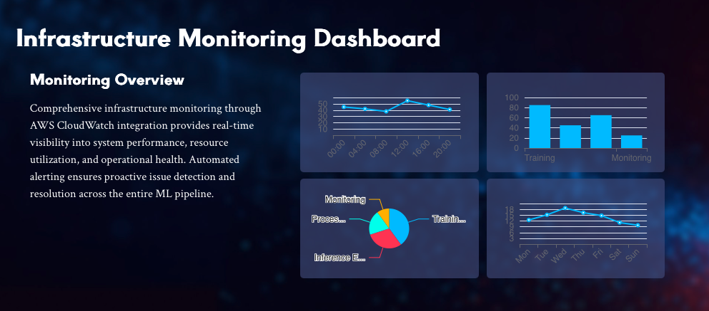
Notes:
Slide 7 – Model Deployment & Endpoint Invocation (5:15 – 6:00)“After training, the model is wrapped using SKLearnModel and deployed as a real-time SageMaker Endpoint.For example, the JSON input {“texts”:[“Amazing food!”, “The burger was cold.”]}returns [5, 2].The endpoint auto-scales with demand and integrates with Model Monitor to capture payloads, latency, and accuracy metrics continuously.”

Slide 8
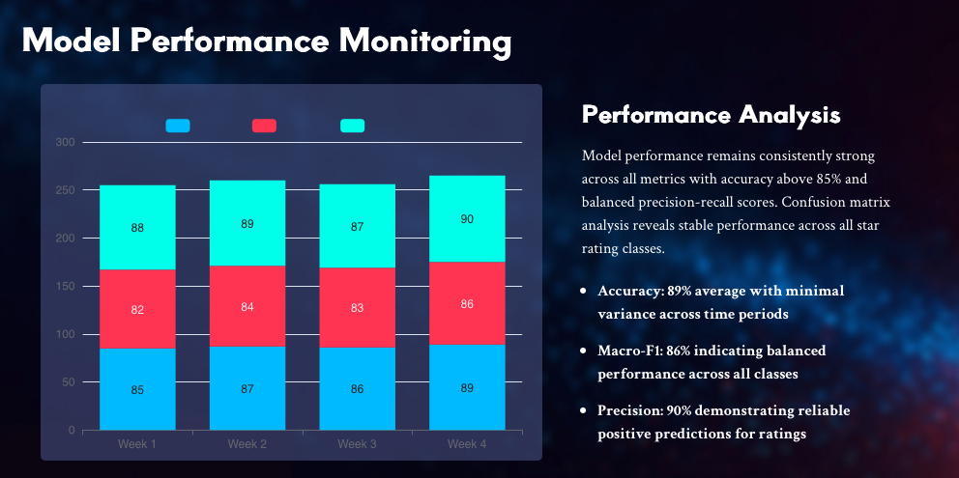
Notes:
Slide 8 – Model Monitoring & Dashboards (6:00 – 6:45)“Operational validation doesn’t end at deployment.SageMaker Model Monitor checks for input-data drift, prediction drift, and latency anomalies.Metrics stream into Amazon CloudWatch, where dashboards visualize trends and trigger alerts when thresholds are breached.This ensures model reliability and compliance over time.”

Slide 9
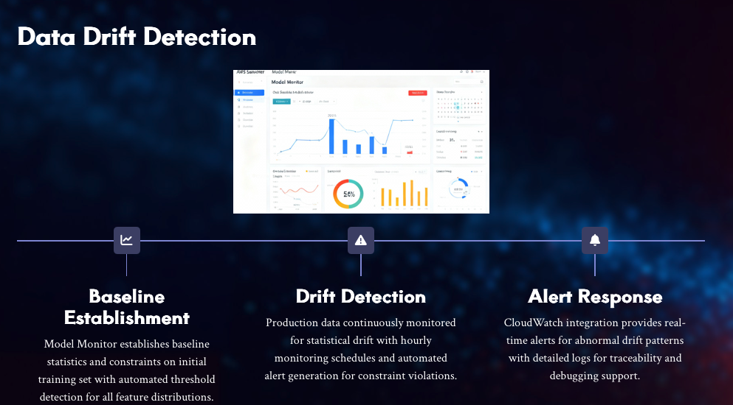
Notes:
Slide 9 – CI/CD Pipeline (CodePipeline) (6:45 – 7:30)“Automation is essential for sustainable ML.Our CodePipeline stages include Source from GitHub, Build with CodeBuild, Train via SageMaker, Deploy to Endpoint, and Monitor through CloudWatch.Whenever new code or data lands in the repository, the pipeline retrains and redeploys the model automatically.Failed stages stop promotion, ensuring that only validated models reach production.”

Slide 10
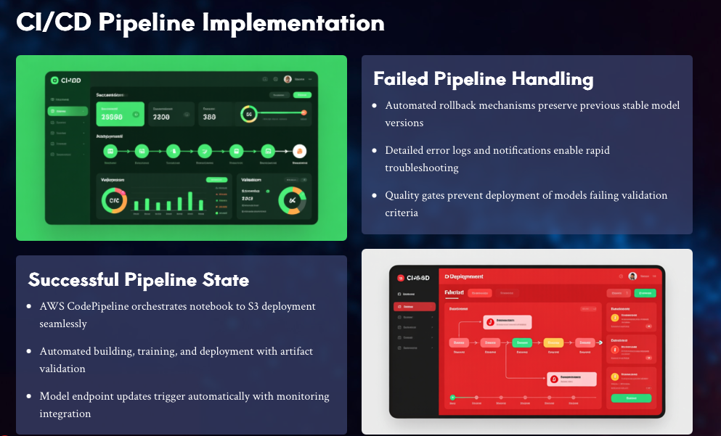
Notes:
Slide 10 – Model Registry & Versioning (7:30 – 8:15)“Every trained model is captured in the SageMaker Model Registry.Each version stores its metrics, lineage, and approval status—Staging or Production.This provides governance, rollback safety, and reproducibility.Auditors or engineers can see exactly which dataset and code produced a deployed model.”

Slide 11
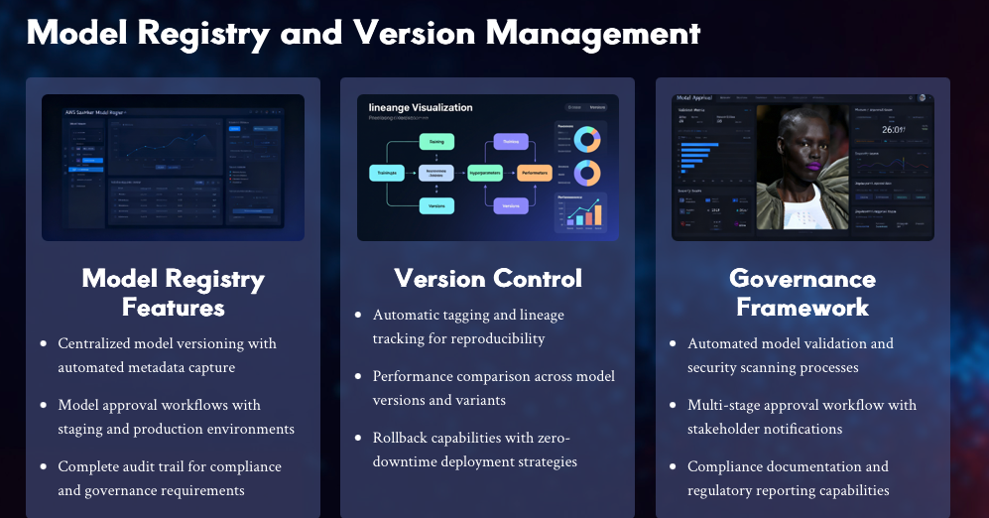
Notes:
Slide 11 – Batch Inference Demonstration (8:15 – 8:45)“Beyond real-time inference, we support batch predictions through SageMaker Batch Transform.Large datasets in S3 are processed offline, and predictions are written back to S3 for reporting and analytics.This approach is ideal for periodic scoring or validation across millions of reviews.”

Slide 12
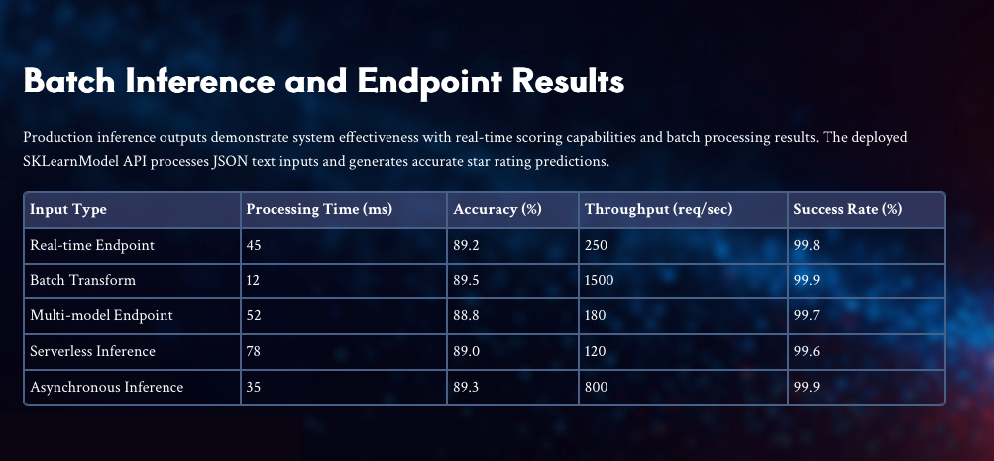
Notes:
Slide 12 – Risks, Challenges & Future Work (8:45 – 9:30)“We faced several challenges—limited SageMaker quotas, data imbalance between positive and negative reviews, and infrastructure cost optimization.Risks include data drift, bias in user-generated text, and ethical concerns over automated sentiment labeling.Future work includes adopting transformer models like BERT, automating retraining with Pipelines, and adding bias-explainability dashboards.”

Slide 13
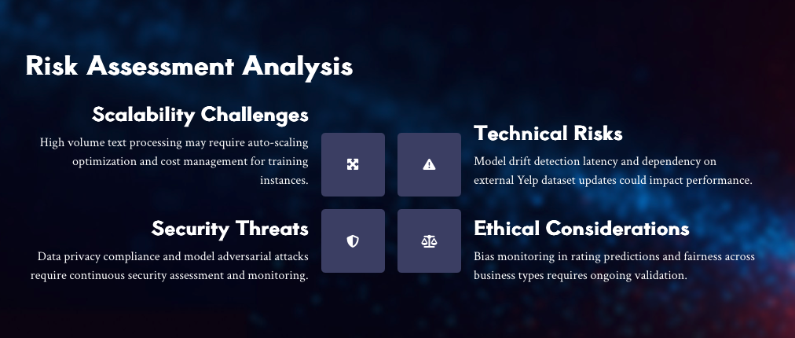
Notes:
Slide 13 – Summary & Takeaways (9:30 – 10:00)“To summarize, we validated a complete ML system that automates Yelp review rating prediction using AWS SageMaker.The solution covers data engineering, feature storage, model training, CI/CD automation, and continuous monitoring—all with scalable, transparent, and ethical ML practices.

Slide 14
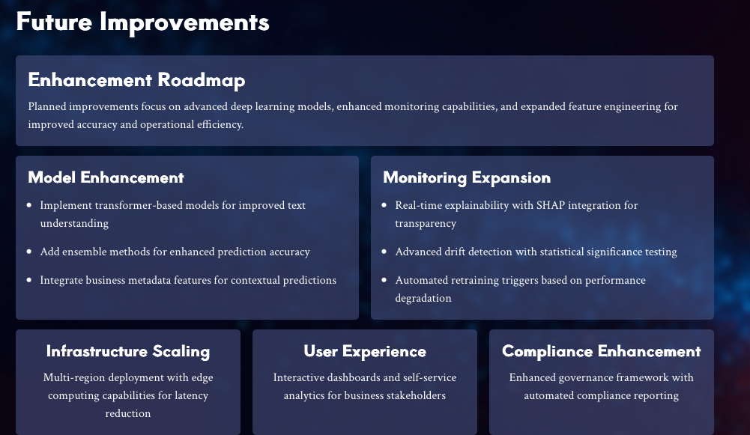

Slide 15
